Slide 1

THEME: DIGITAL LITERACY
OUR PROJECT: SkillUp Safe
A gamified platform empowering women and girls to stay safe online.
Team: Group 46
“Digital Literacy for All. Safety for Everyone.

Slide 2
OUR TEAM MEMBERS
  D'vock Akoi - Project Lead/System Manager
  Abigael Cheptoo - Presentation/Pitch Deck
  Brian Kipchumba - Frontend Development
  Dorcas Wanjiru - UI/UX Designer
  Newton Kiogora - Content Planner
  Abdulrahman Daud - Quality Assurance

Slide 3
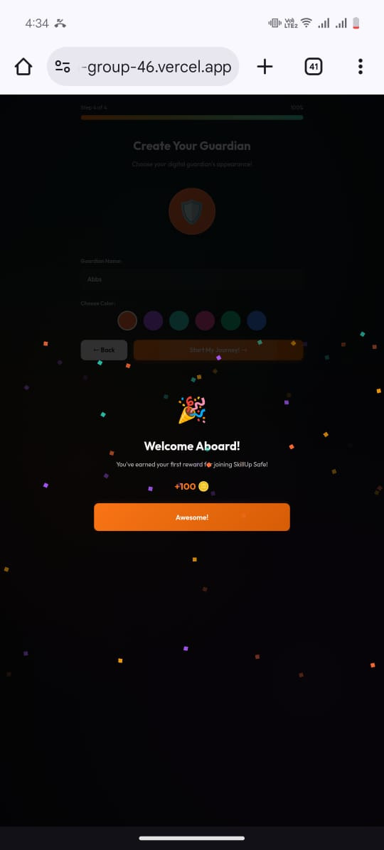
The Crisis of Digital Abuse
  Women and girls face disproportionate levels of online harassment, cyberbullying, grooming, stalking, sextortion, and misinformation.
  Over 70% of young women globally report experiencing digital violence.
  Lack of digital literacy, especially in young girls, increases vulnerability.
  Existing tools are boring, text-heavy, or reactive — not preventive.

Slide 4

Defining Digital Abuse
Cyberstalking
Online Harassment
Cyberstalking involves repeated harassment or threatening behavior conducted online, causing emotional distress to victims.
Online harassment includes unwanted comments, threats, or abuse directed at individuals through digital platforms and social media.
Doxing
Identity Theft
Doxing is the act of publicly revealing private information about individuals, often leading to harassment or harm.
Identity theft occurs when someone unlawfully uses another person's personal information to commit fraud or deception.

Slide 5
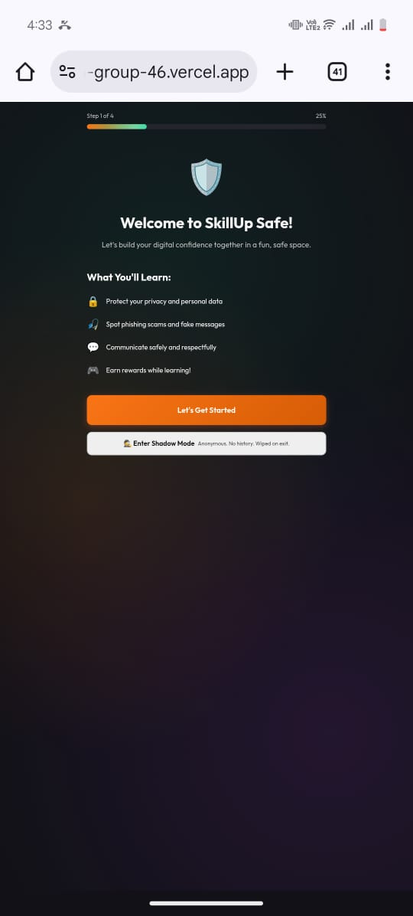
OUR SOLUTION
A game that teaches digital safety in fun, interactive, and memorable ways.
  🎮 Story-based missions teaching online safety
  🛡️ Scenarios on cyberbullying, grooming, phishing & consent
  🎁 Rewards & badges for safe choices
  🔍 Decision-making challenges reflecting real online situations
  📚 Mini-lessons after each level
  🧠 Behaviour-change design based on gamification science

Slide 6
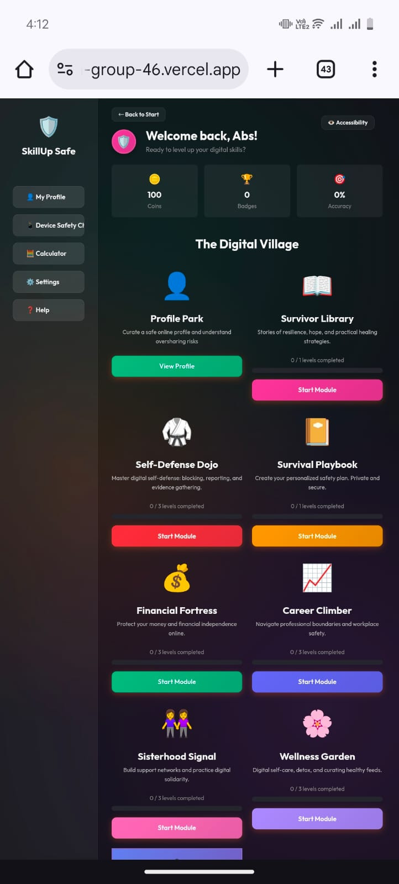
Game Concept
Level 1: Spot the Cyberbully
Level 2: Decode the Grooming Attempts
Level 3: Phishing Messages Challenge
Level 4: Digital Consent & Boundaries
  Presents a real scenario
  Player chooses what action to take
  Immediate feedback teaches safe behavior

Slide 7
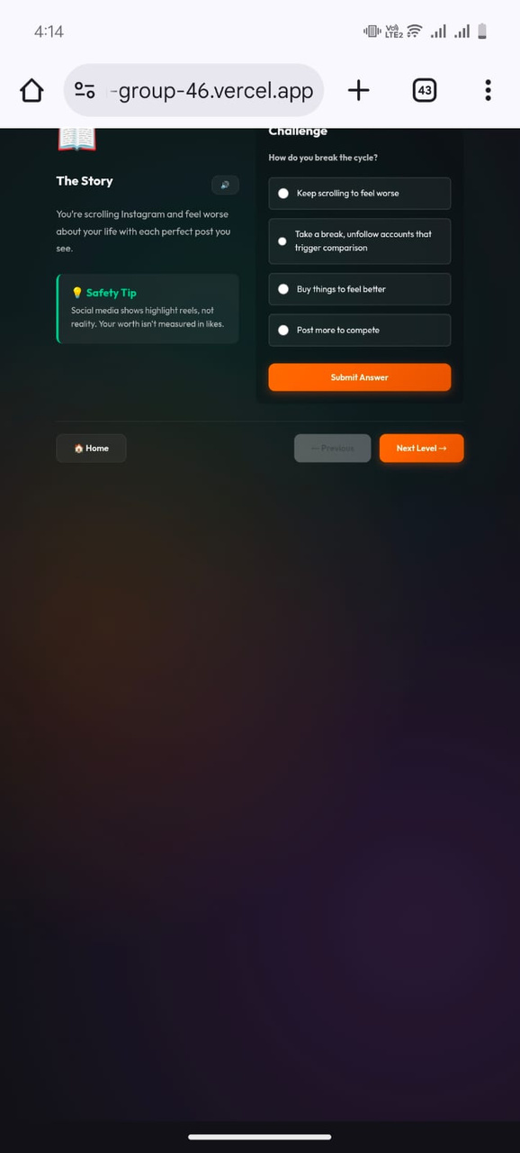
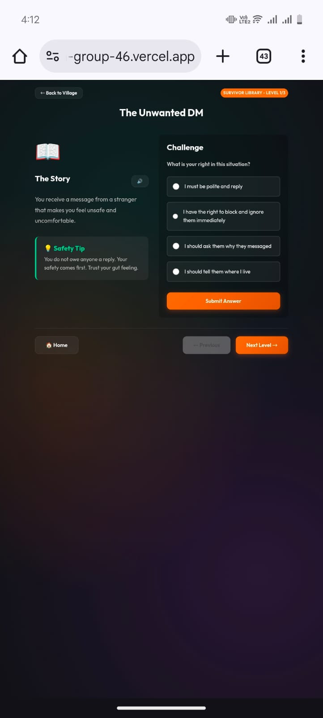
Game Mechanics: Engaging Learning Experiences
01
03
02
Scenario
Consequences
Players navigate real-life inspired situations interactively.
Real-world impacts are felt through gameplay experiences.
Decision
Choices lead to meaningful consequences and reflections.

Slide 8
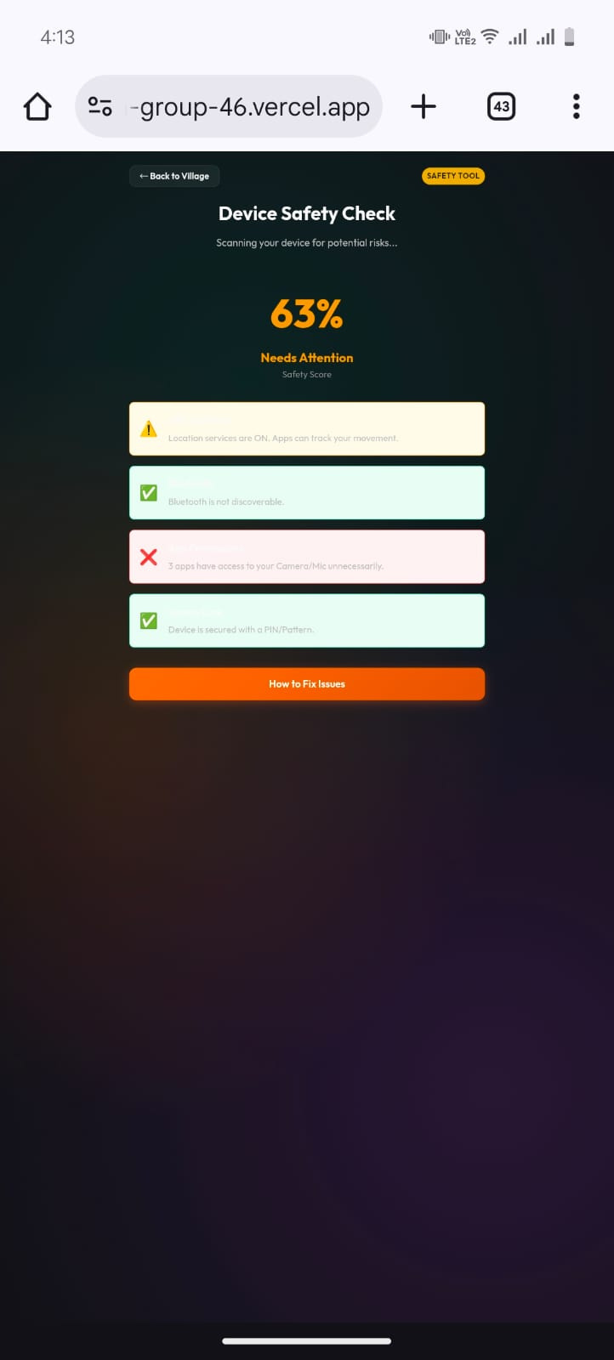
WHY A GAME
  Young people learn best through interactive play.
  Games increase knowledge retention by 50–80%.
  Safe simulations allow players to practice digital defense skills without real risk.
  Unlike classroom digital literacy, this is fun, immersive, and self-paced.

Slide 9
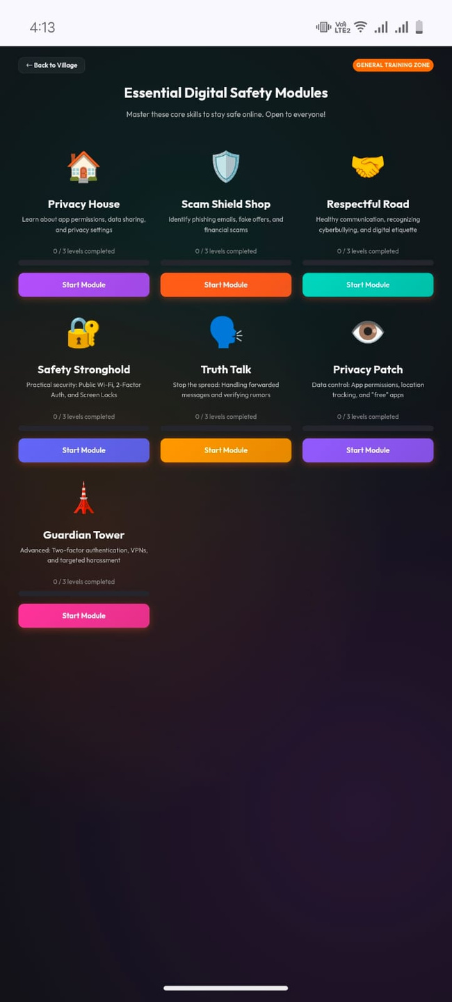
Accessibility Features for Our Game
01
03
02
Compatibility
Inclusivity
Works seamlessly across various platforms and devices.
Designed to cater to diverse experiences and needs.
Intuitiveness
Simple navigation ensures users of all backgrounds succeed.

Slide 10

Collaborative Partnerships
  Schools integrating digital literacy into curriculum
  NGOs working on GBV prevention
  Government e-safety programs
  Parents seeking safe learning platforms
  EdTech and health-tech ecosystems

Slide 11
Launch Plan & Enhancements
Phase 1: Prototype + Test with 50 young people
Phase 2: Core game development
Phase 3: Partnerships with schools, youth groups & NGOs
Phase 4: Scaling across Kenya & beyond

Slide 12


Competitive Advantage of Our Game
01
03
02
Unique
Scalability
Engagement
Gamified, not just educational
Expansion potential to reach wider audiences effectively.
Accessible (web-based, mobile-first)

Slide 13

OUR ASK
  Support in scaling the prototype
  Mentorship
  Funding for further game development
  Access to networks working on women’s digital safety

Slide 14
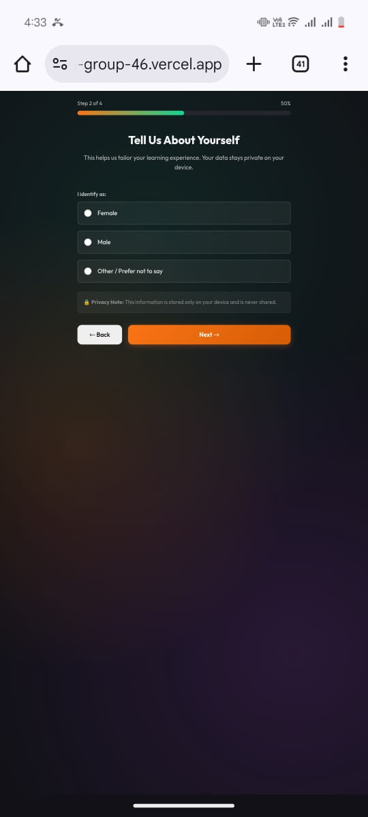
Addressing Gender Equality and Safety
01
03
02
Equality
Empowerment
Promoting equal rights for women online and offline.
Safety
Encouraging women to take control of their digital presence.
Ensuring a protected environment for all users online.

Slide 15

Our Funding Request
To successfully develop and expand our game, we seek funding for enhancements, marketing, and community outreach. Investment will enable us to create impactful changes, improve user experience, and broaden our reach in combating digital abuse against women and girls.

Slide 16


MIND A TOUR TO OUR GAME?
click on the link below to access:
HTTPS://HACKATHON-GROUP-46-QFCDE12EI-AKOI100S-PROJECTS.VERCEL.APP

